Slide 1

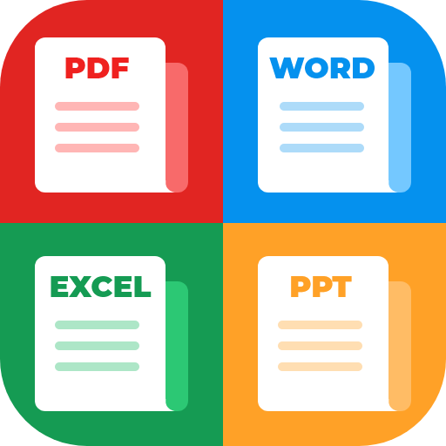
PDF Viewer＆Scanner
Browsing, editing and searching

Slide 2


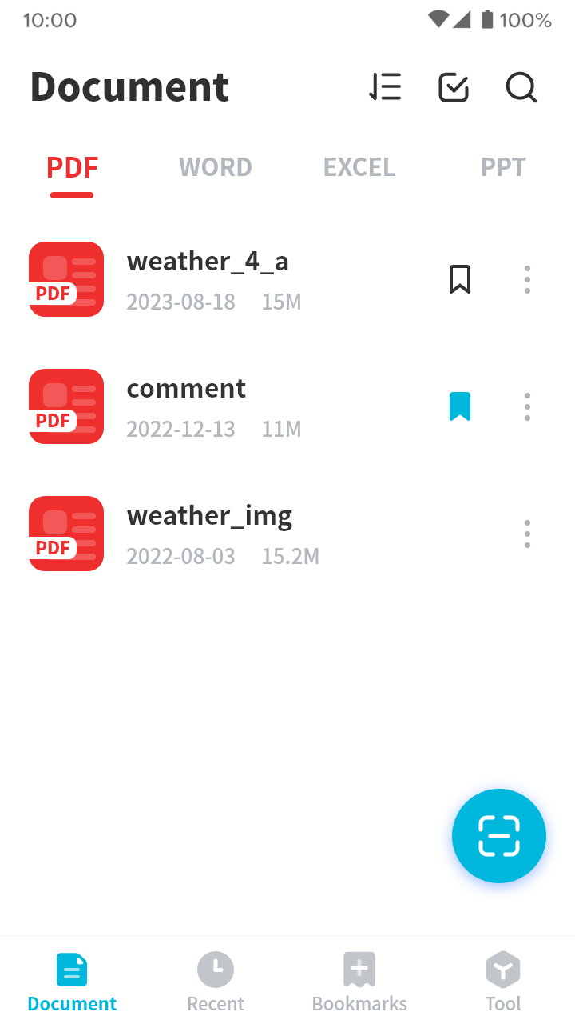
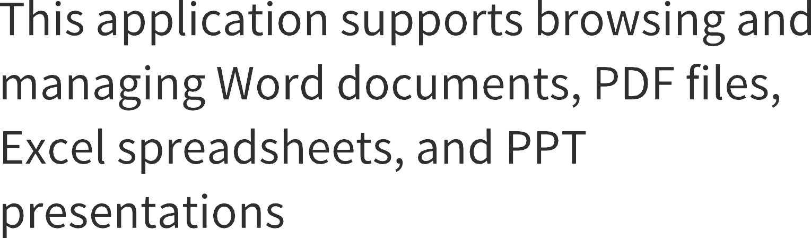





View Multiple Types of Files
This application supports browsing and managing Word documents, PDF files, Excel spreadsheets, and PPT presentations

Slide 3
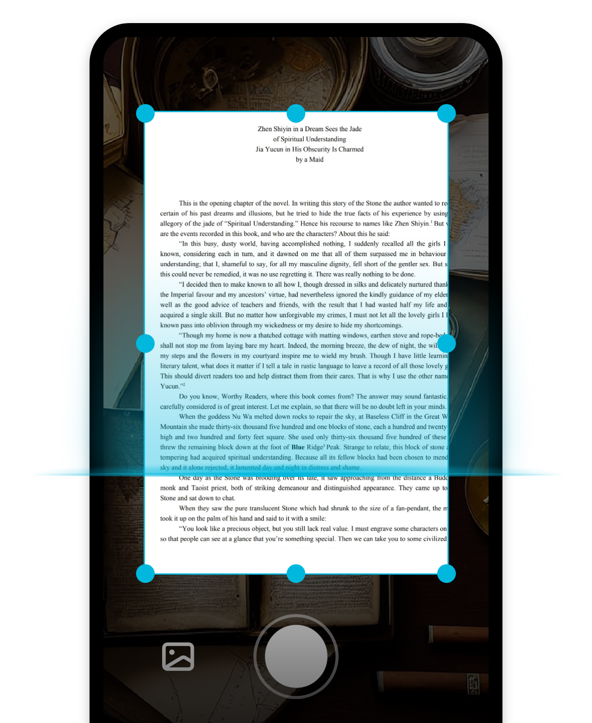

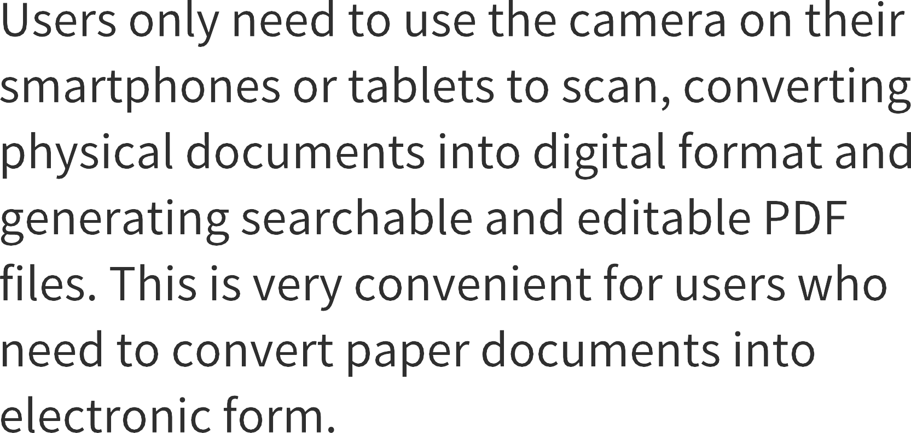
Scan Files to
Generate PDF Files
Users only need to use the camera on their smartphones or tablets to scan, converting physical documents into digital format and generating searchable and editable PDF files. This is very convenient for users who need to convert paper documents into electronic form.

Slide 4
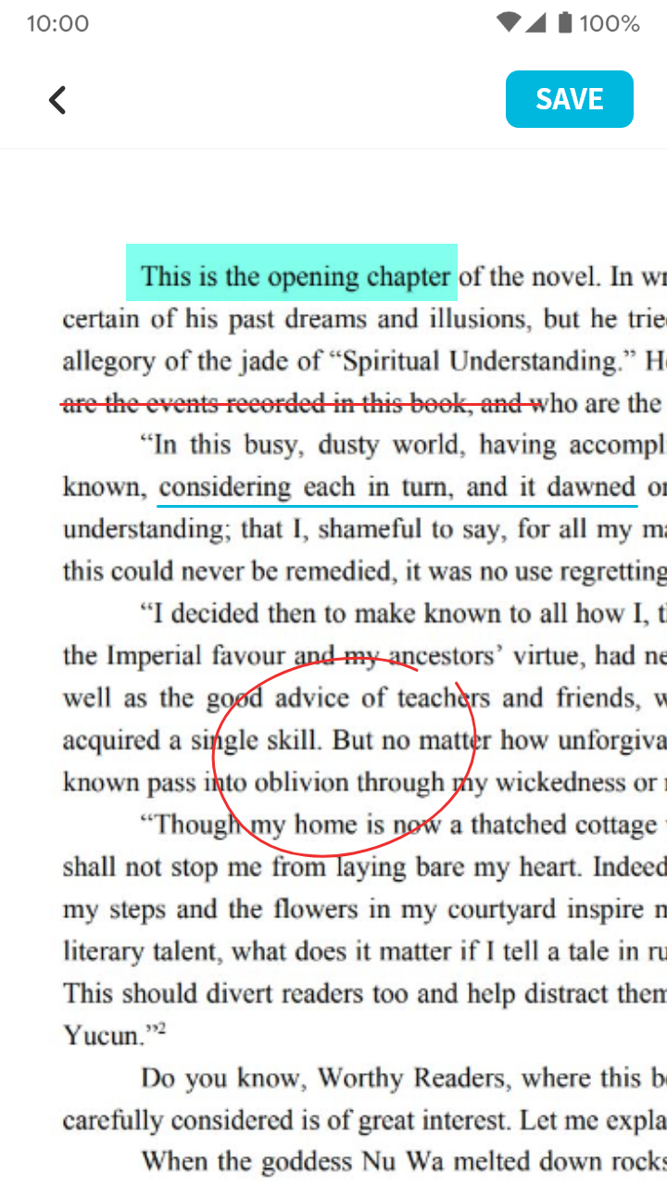

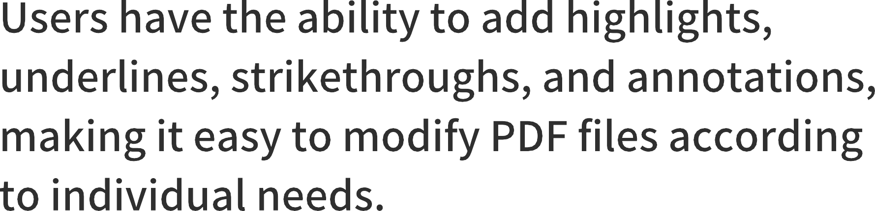


Support for
Editing PDF Files
Users can add highlights, underlines, strikethroughs, graffiti, etc. to easily modify PDF files to meet personalized needs.
Highlight
Underline
Stripper l ine
Paintbrush

Slide 5
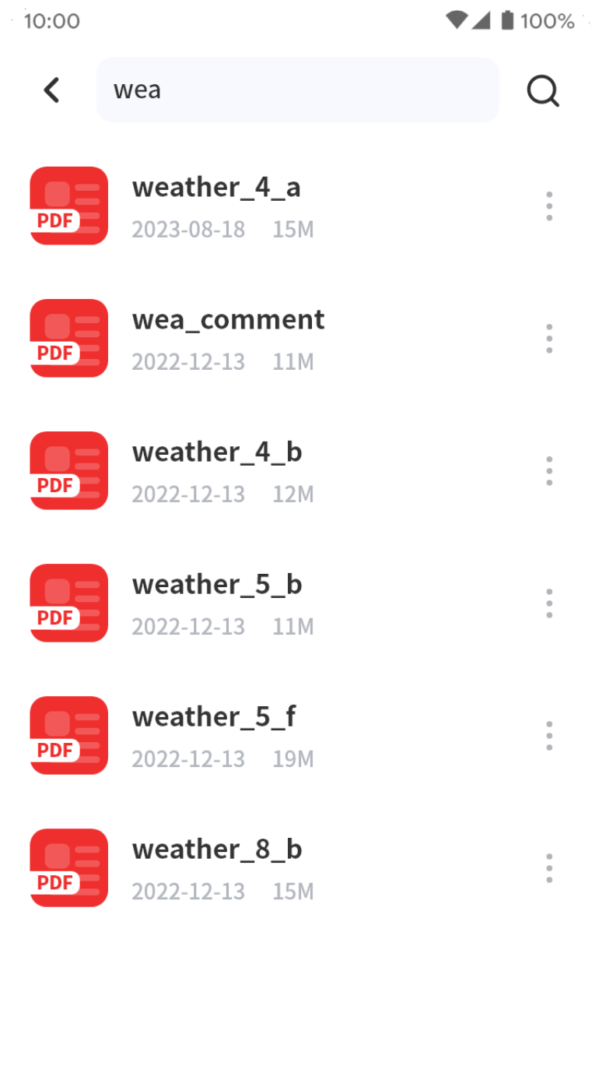
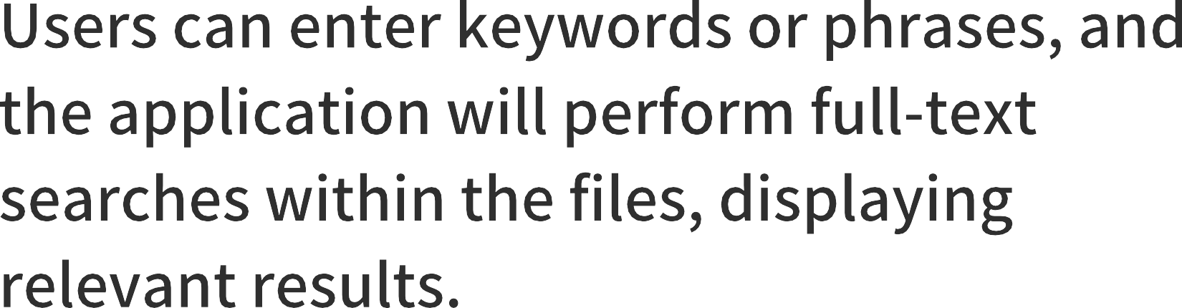


Search Files Easily
Users can enter keywords or phrases, and the application will perform full-text searches within the files, displaying relevant results.
Weather_im.pdf
2022-08-03 15.2M
PDF

